Slide 1
Osher Lifelong Learning Institute, Fall 2026
Contemporary Economic Policy
University of Massachusetts, Boston
Host: Geoffrey Woglom, Director
National Economic Education Delegation

Slide 2
Course Schedule
Contemporary Economic Policy
  Week 1 (9/16): Economic Update & Changes at the Fed, Geoffrey Woglom, Amherst College
  Week 2 (9/23): Economic Inequality, Joseph Carolan, Oakland University
  Week 3 (9/30): Saving Social Security, Geoffrey Woglom, Amherst College
  Week 4 (10/07): Federal Debt, Dmitriy Stolyarov, University of Michigan
  Week 5 (10/14): Trade and Globalization, Andreas Waldkirch, Colby College
  Week 6 (10/21): Climate Change Economics, Sarah Jacobson, Williams College

Slide 3
Submitting Questions
Submit questions in the chat. I will try to address questions as they come up (but I may wait until a good transition point in the material to address them).
Time permitting we will do a verbal Q&A once the material has been presented.
Slides will be available from the NEED website tonight or tomorrow https://needecon.org/delivered_presentations.php.

Slide 4


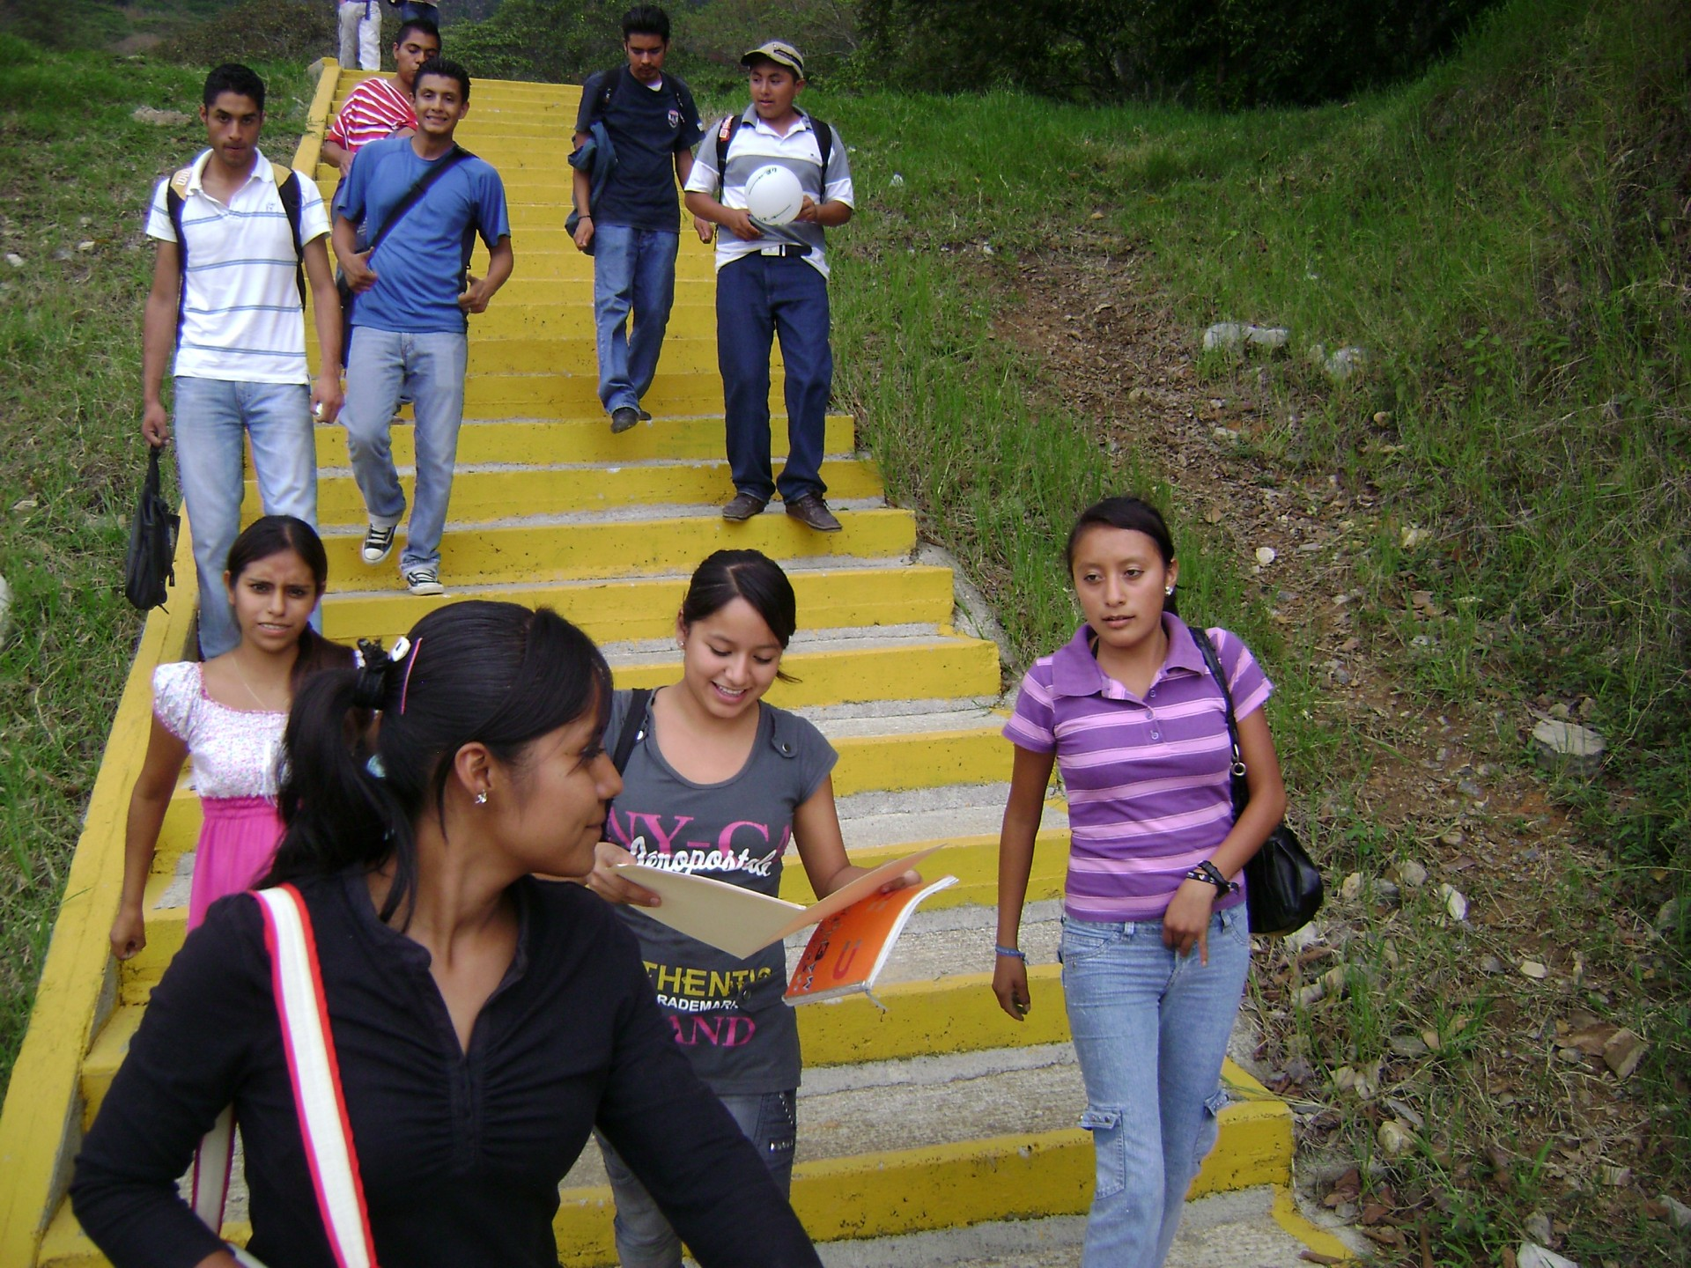
Economic mobility
Joe Carolan, Ph.D.
Oakland University
Sept. 23, 2026
<location/audience>
<date>
Notes:
M

Slide 5
Endowed with resources
Decisions community makes over time impacts ability to do this
Communities use resources to satisfy people’s needs & wants

Slide 6
Endowed resources
Endowed resources
Time & generations and choices
Economy A – needs & wants
Economy B – needs & wants

Slide 7

Let’s do an exercise

Slide 8
After Men in Black wipe your memory, you awake and get to pick which economy you want to live in
Choice: Two economies (A or B)
This is each economy AT THE CURRENT STATE (note: this changes over time as above)
When you pick an economy, you don’t get to pick whether you are in “top” category or “other” category – the probability of being in each will be included below
ECONOMY A | top | other | AVG | Total
% in category | 10% | 90%
# in category | 35 | 315
N/W satisfied | 250 | 30 | 52 | 18200
ECONOMY B | top | other | AVG | Total
% in category | 50% | 50%
# in category | 175 | 175
N/W satisfied | 50 | 40 | 45 | 15750

Slide 9
Poll results

Slide 10
Economic mobility
<location/audience>
<date>
Notes:
M

Slide 11
Big picture – why does it matter?

Slide 12
Credits and Disclaimer
This slide deck was authored by:
  Oana Tocoian, UCSD
  Kathryn Wilson, Kent State University
  Jon Haveman, NEED
Disclaimer
  NEED presentations are designed to be nonpartisan.
  It is, however, inevitable that the presenter will be asked for and will provide their own views.
  Such views are those of the presenter and not necessarily those of the National Economic Education Delegation (NEED).

Slide 13
Outline
I. What do we mean by economic mobility?
II. Empirical patterns of economic mobility
III. What is the desirable level of economic mobility?
IV. Exploring channels/barriers to upward mobility and policy options

Slide 14
I. What do we mean by economic mobility?
Definition and motivation

Slide 15
Economic Mobility – Defined
I. What do we mean by economic mobility?
Economic Mobility – Our working definition:
  Ability to advance beyond the status of your parents.
Variety of measures:
  Income
  Wealth
  Education level
  Occupation
  Home ownership
More Broadly:
The ability to improve your socioeconomic class.
We will consider intergenerational mobility in INCOME.

Slide 16

Absolute and Relative Mobility
I. What do we mean by economic mobility?
Absolute mobility: the difference in income from one’s parent.
    You’re higher on the escalator than your parents were at that same age.
    It is possible for everyone to experience upward absolute mobility, especially if the escalator is going up.
Relative mobility: the change in income rank from one’s parent.
    You have fewer people above you on the escalator than your parents did.
    Increased relative mobility requires both upward and downward movement.

Slide 17
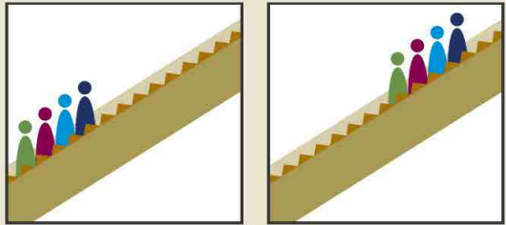
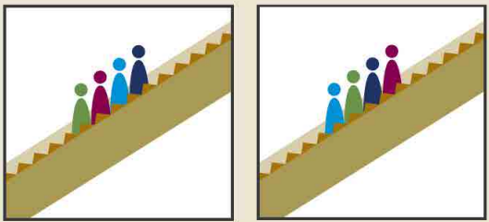
More on Absolute vs Relative Mobility
I. What do we mean by economic mobility?
Can there be absolute mobility with NO relative mobility?
  Yes: if everybody experiences the same increase in income, there will be no relative mobility.
Can there be relative mobility with NO absolute mobility?
  Yes: There can be a dramatic reshuffling of the distribution even if there is no increase in average income.
Parents Kids
Parents Kids
+2
-1
+1
-2

Slide 18
Economic Growth and Mobility
I. What do we mean by economic mobility?
Economic growth should drive absolute mobility
  It has the potential to raise all incomes.
  But the extent of mobility that results depends on how income is distributed.
Economic growth and relative mobility are unrelated
  Growth does not have implications whether kids are more or less likely to rise above their parent’s position in the income distribution.

Slide 19
II. Empirical patterns of Economic Mobility
What are the facts?

Slide 20
Mobility – Big Picture for Absolute Mobility
II. Empirical Patterns of Economic Mobility
Decline in absolute mobility in the United States:
  90% of those born in the early 1940s could expect to earn more than their parents in real terms. For millennials, the fraction is closer to 50%
  Below-median earnings have not increased in real terms since the 1970s.

Slide 21
II. Empirical Patterns of Economic Mobility
9 out of 10 of those born in the early 1940s could expect to earn more than their parents
  1 in 2 Millennials (born after 1980) earn more than their parents.
Year of Birth

Slide 22
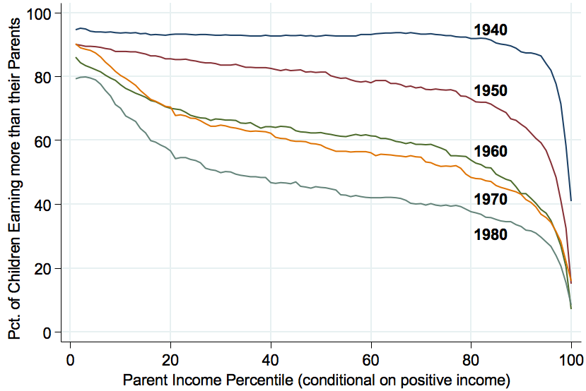
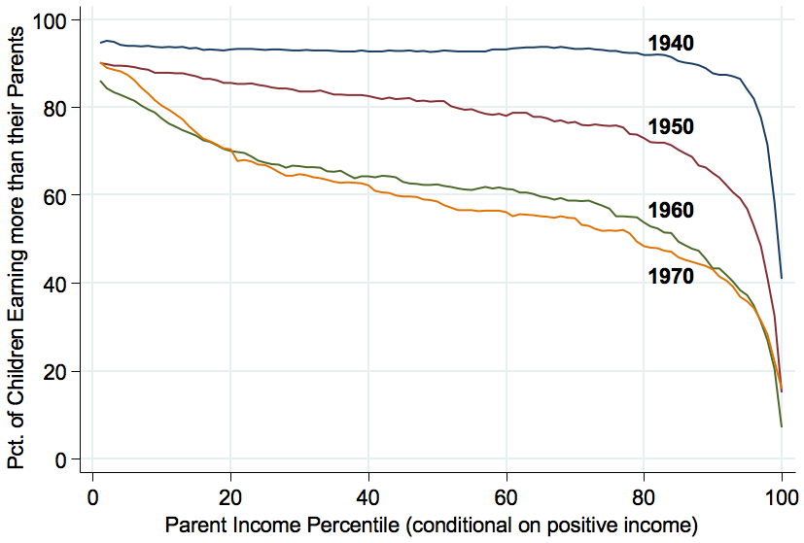
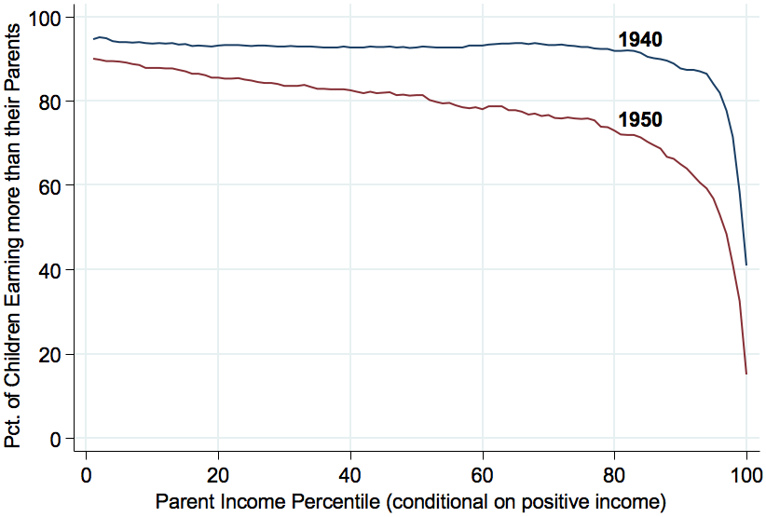
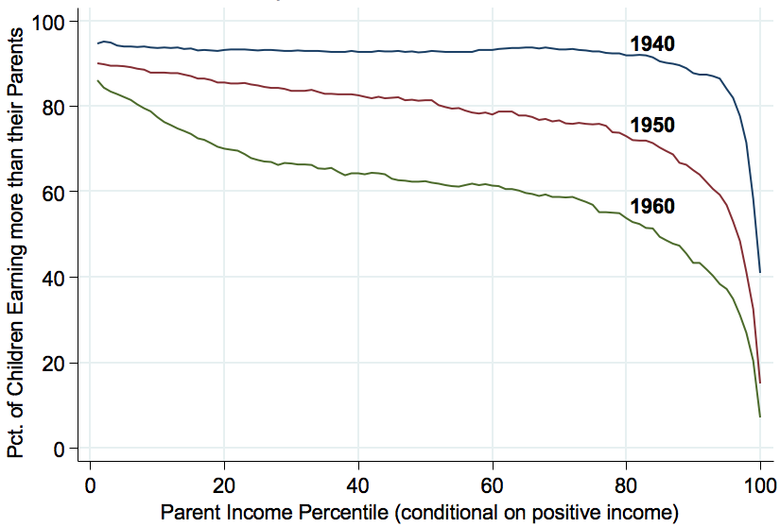
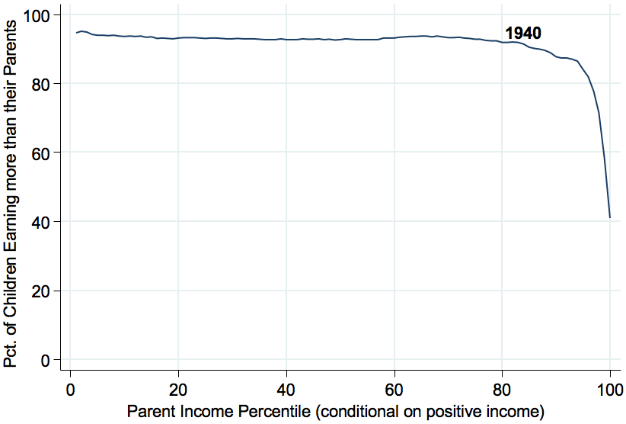
Absolute Mobility by Birth Cohort
II. Empirical Patterns of Economic Mobility
94%
93%
88%
70%
45%
33%

Slide 23
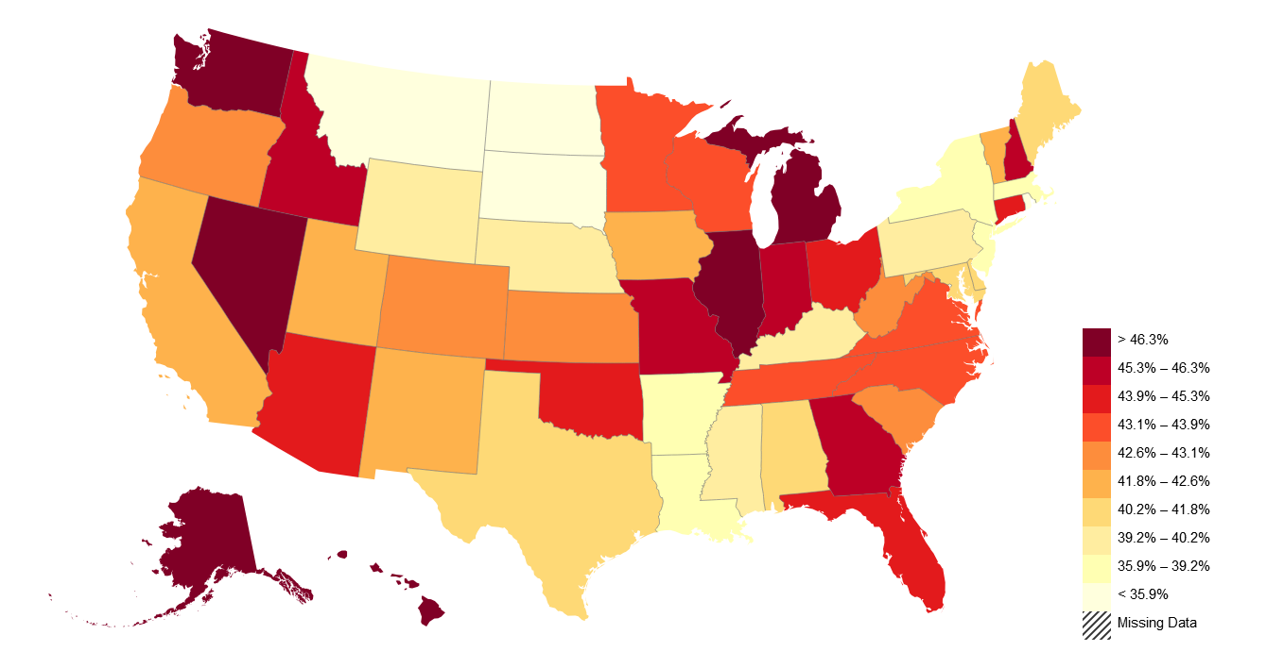
American Dream: Geography Matters
II. Empirical Patterns of Economic Mobility
Trends in Absolute Mobility by State: Change from 1940-1980
Decline in Abs. Mob. from 1940-80
https://opportunityinsights.org/paper/the-fading-american-dream/

Slide 24
Measuring Relative Mobility
II. Empirical Patterns of Economic Mobility
Reminder: Relative mobility is the change in income rank from one’s parent.
Transition Probabilities: Likelihood that an individual ends up in a different income quintile than their parents.
Perfect Mobility: For each of the parental income quintiles, 20% of their offspring end up in each income quintile as adults.
Quintile | Bottom (below 20%) | Lower (20% to 40%) | Middle (40% to 60%) | Upper (60%-80%) | Top (above 80%)
Income | Below $30,000 | $30,000-$58,000 | $58,000-$94,000 | $94,000-$153,000 | Above $153,000

Slide 25
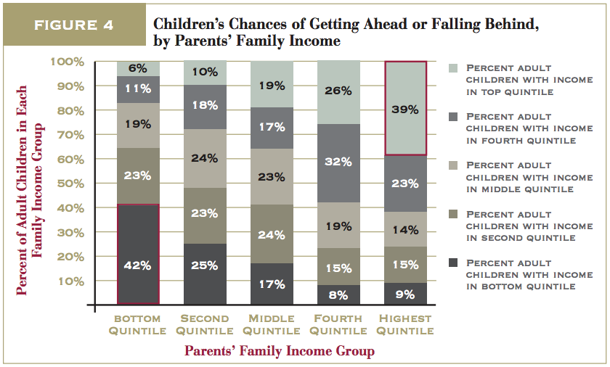
Transition Probabilities in the United States
II. Empirical Patterns of Economic Mobility
https://www.brookings.edu/wp-content/uploads/2016/06/11_generations_isaacs.pdf

Slide 26
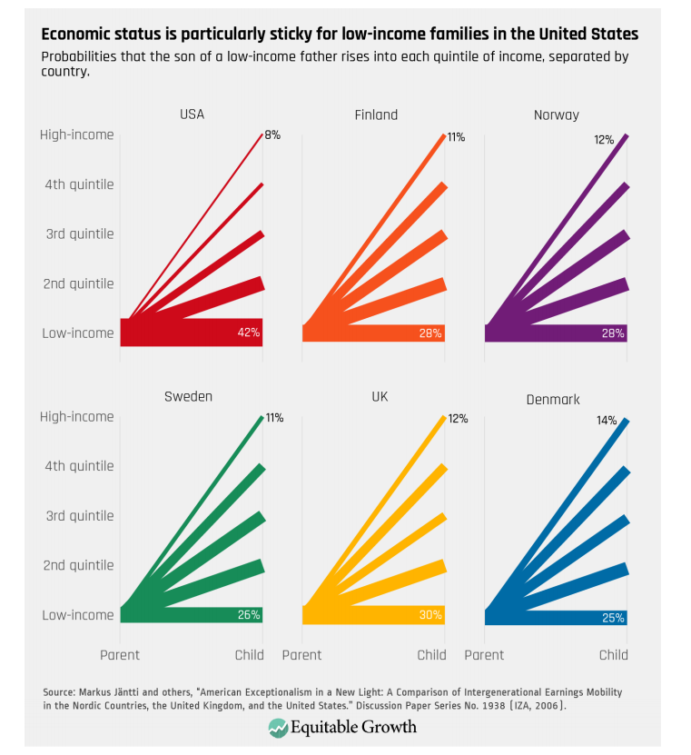
Transitions: International Comparisons
II. Empirical Patterns of Economic Mobility
Source: : https://equitablegrowth.org/research-paper/are-todays-inequalities-limiting-tomorrows-opportunities

Slide 27
American Dream: Geography Matters
II. Empirical Patterns of Economic Mobility
https://www.brookings.edu/blog/social-mobility-memos/2018/01/11/raj-chetty-in-14-charts-big-findings-on-opportunity-and-mobility-we-should-know/

Slide 28
Summary of Empirical Patterns
II. Empirical Patterns of Economic Mobility
Absolute economic mobility in the United States has been in decline since the 1940s
  Half of people born in the mid-1980s have not outperformed their parents in terms of income
Relative mobility is lower in the United States than many developed countries
  Income is especially “sticky” at the bottom and the top of the income distribution
Geography matters – there is tremendous variation in mobility within the United States

Slide 29
III. What is the desirable level of economic mobility?
Economically what is optimal? What do people think is optimal?
Mobility and Inequality

Slide 30
Absolute or Relative Mobility?
III. What is the Desirable Level of Economic Mobility
Upward absolute mobility of the whole population is unambiguously desirable (it’s hard to defend not wanting everyone to be better off!)
  The fact that half the population is treading water should worry us.
But, relative mobility is a zero-sum game: for some people to rank higher than their parents did, others have to rank lower.

Slide 31
The “Right” Level of Relative Mobility
III. What is the Desirable Level of Economic Mobility
Efficiency
  Want to provide incentives in order to get economic growth
Equity
  Want a system that is “fair”
What is the optimal level of relative mobility?
  This is a hard question, one which we may not be able to answer or agree on.
Is current relative mobility too low (or too high)?
  The answer would suggest the best incremental steps to take towards a better outcome, and policy changes are best done in incremental steps in any case.

Slide 32
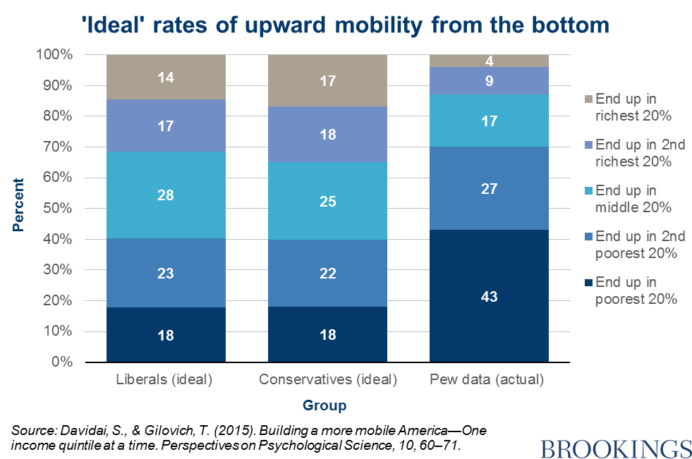
Survey Says on Upward Mobility from the BOTTOM
III. What is the Desirable Level of Economic Mobility

Slide 33
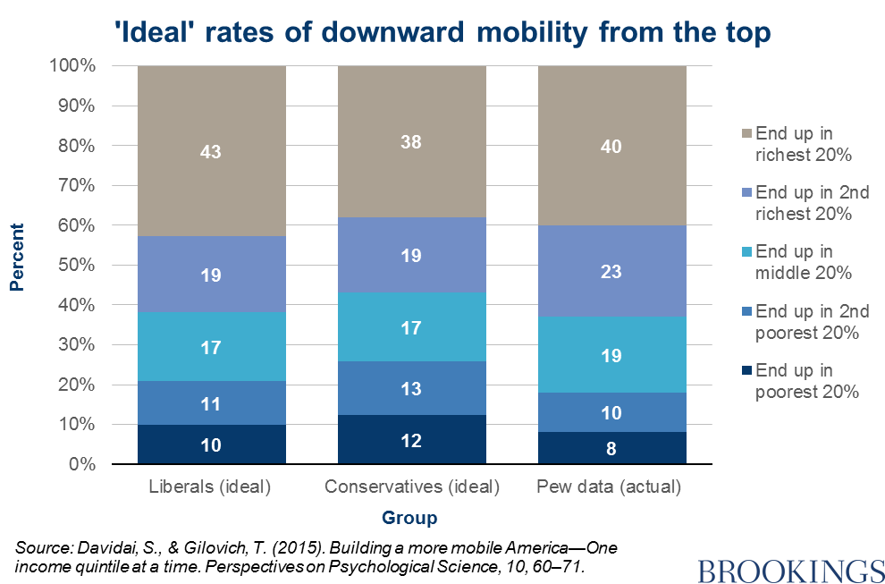
Survey Says on Downward Mobility from the TOP
III. What is the Desirable Level of Economic Mobility

Slide 34
Preferences hit Awkward Truth: Math
III. What is the Desirable Level of Economic Mobility
Again: relative mobility is a zero-sum game
  There are only so many spots in the top quintile (only 20% of population can be there)
    Preferences want:
      43% of them for kids born into the top
      16% for those born into the bottom
      Leaves about 14% for each of the other 3 quintiles
    Preferences are inconsistent
      Greater upward mobility for the bottom than the middle?
Results are intuitive:
  Stickiness at the top
  Mobility from the bottom
…but inconsistent:
  What about the middle?

Slide 35
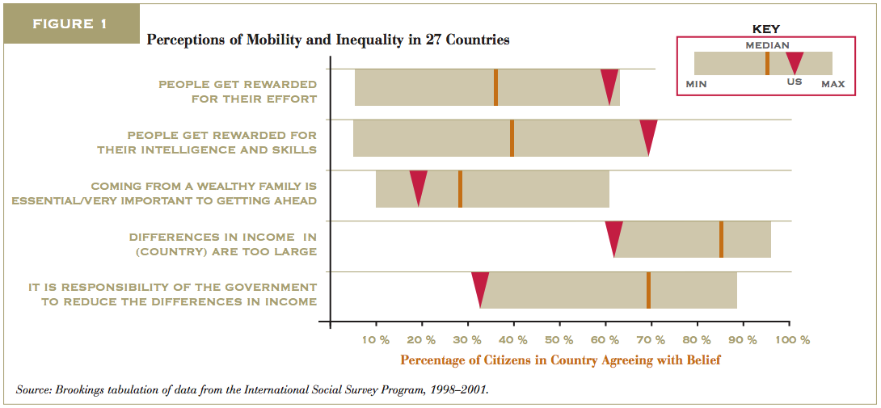
The “American Dream” Shapes Perceptions
III. What is the Desirable Level of Economic Mobility
https://www.brookings.edu/wp-content/uploads/2016/06/02_economic_mobility_sawhill.pdf

Slide 36
IV. Exploring channels/barriers to upward mobility and policy options
Focus on Education and Career Opportunities

Slide 37
Barriers to Upward Mobility
IV. Exploring Channels/Barriers to Upward Mobility and Policy Options
Key Question:
What are the factors that might prevent someone born
in a low-income household from doing as well as their
richer counterpart?
Answers:
  Birth Lottery
  Structural barriers

Slide 38
Barriers to Upward Mobility – Birth Lottery
IV. Exploring Channels/Barriers to Upward Mobility and Policy Options
Early advantages
  Innate (genetic) advantages:
    Inherited ability, medical conditions, psychological traits
  Environmental factors:
    In utero: pre-natal care, mother’s nutrition, exposure to abuse or stress.
    Home environment which promotes healthy development, transmission of family values
    Availability of role models, mentors, neighborhood effects.
    Availability of good educators, facilities, peers

Slide 39
Barriers to Upward Mobility – Structural
IV. Exploring Channels/Barriers to Upward Mobility and Policy Options
Selective access to quality higher education
  Preferential admission for legacy and donor families.
  Expectation of extra-curricular activities, AP classes, etc.
Effective access to family planning (sex ed, contraceptives, abortion)
  Teen births reduce outcomes for both mother and child.
Access to lucrative employment
  Reliance on personal connections, homophily, racism, sexism...
Access to entrepreneurship and invention
  initial capital and insurance against negative shocks, social networks.
Direct transmission of income-earning assets

Slide 40
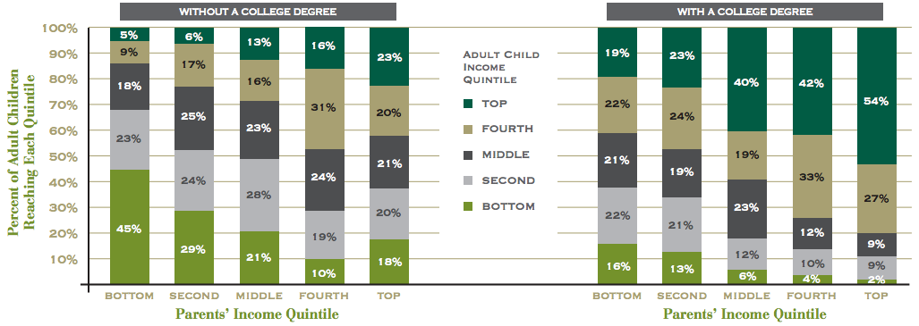
Education: an Avenue and Barrier to Mobility
IV. Exploring Channels/Barriers to Upward Mobility and Policy Options
https://www.brookings.edu/wp-content/uploads/2016/06/02_economic_mobility_sawhill.pdf

Slide 41
College Attendance Rates – by Parent’s Income
IV. Exploring Channels/Barriers to Upward Mobility and Policy Options
100%
80%
60%
Percent in College at 19
84-87 Slope = 0.745
40%
(0.008)
20%
0
20
40
60
80
100
Parent Income Rank
https://opportunityinsights.org/paper/recentintergenerationalmobility/

Slide 42
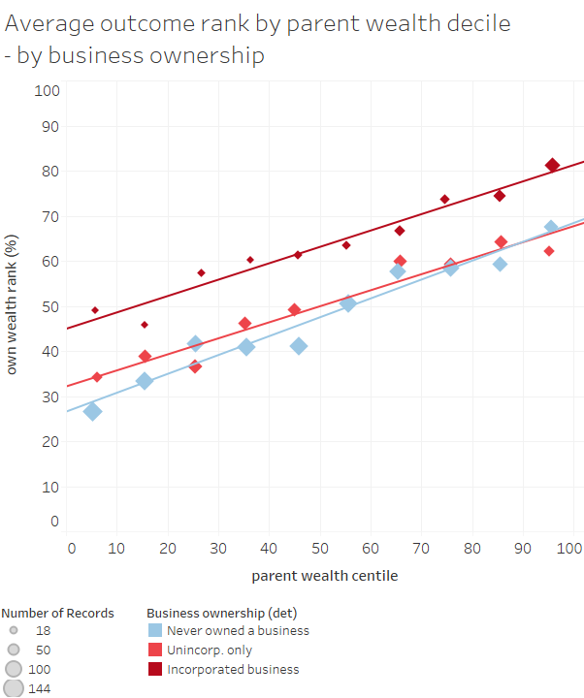
Career Opportunities – an Avenue and Barrier to Mobility
IV. Exploring Channels/Barriers to Upward Mobility and Policy Options
Ownership of a business is a big indicator of wealth accumulation
Children from a wealthy family are more likely to incorporate a business
Graph from Sarada and Tocoian (2018)

Slide 43
Policy Options
IV. Exploring Channels/Barriers to Upward Mobility and Policy Options
Investments in education
  Make preparedness for college more universally available.
Entrepreneurship
  Introduce children to it at an early age and seek to reduce barriers to starting a business.
Housing vouchers, public housing, zoning laws
  Help underprivileged children grow up in neighborhoods conducive to mobility.
Implement policies to reduce inequality.

Slide 44
Summary: Economic Mobility
I. What do we mean by economic mobility?
  Absolute vs Relative Mobility
II. Empirical patterns of economic mobility
  Absolute mobility is in decline
  Relative mobility is much lower in the U.S. than elsewhere.
    Brings into question the notion of the “American dream”.
III. What is the desirable level of economic mobility?
  Absolute: concern that 50% of kids are treading water or falling behind.
  Relative: not as much as people seem to think there is.
IV. Exploring channels/barriers to upward mobility and policy options
  Often what is an avenue to mobility at the individual level may be a barrier at the societal level due to structural factors (i.e., Education and Career Opportunities)
  There are plenty of levers to pull to increase mobility.

Slide 45
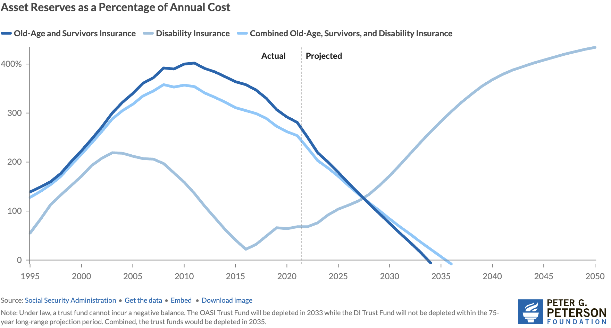
Next Week: Trust Funds Are Running Out
Source: https://www.pgpf.org/article/social-security-faces-serious-financial-shortfalls-and-other-takeaways-from-the-trustees-report/

Slide 46
Thank you!
Any Questions?
www.NEEDEcon.org
Joseph Carolan, Ph.D.
carolan@oakland.edu
Contact NEED: info@NEEDEcon.org
Submit a testimonial: www.NEEDEcon.org/testimonials.php
Become a Friend of NEED: www.NEEDEcon.org/friend.php

